Slide 1

Song metric analysis
William Nash
Cody Braun
Austen Manser

Slide 2
Questions & Data
We wanted to know whether we could find a trend in song metric analysis among songs that made it to number one on the Billboard Top 100 and songs that did not.
To answer this, we needed a list of all the songs that have ever been on the Billboard Top 100 (pulled via Billboard) and the song metrics for all these songs (provided by Spotify).
Settled on using the Spotify API due to robustness and relatability. With 191M active monthly users and 87M paying subscribers as of Q3 2018 Earnings (Nov 1) Spotify owns a lot of music data!

Slide 3
Hypothesis
(Null) H₀ : There is no difference in Spotify song features between songs that have been number one and have not been number one on the Billboard Hot 100 list since 1958.
H₁ : There is a correlation between Spotify song metrics (Popularity, Danceability, Valence, etc.) on number one songs on the Billboard Hot 100 since 1958 and songs that did not make number one on Billboard Hot 100.

Slide 4
Song Metrics Explained
Acousticness:
A confidence measure from 0.0 to 1.0 of whether the track is acoustic. The higher the value the more acoustic the song is (ie not having electrical amplification).
Danceability:
The higher the value, the easier it is to dance to this song. Danceability describes how suitable a track is for dancing based on a combination of musical elements including tempo, rhythm stability, beat strength, and overall regularity.
Energy:
The energy of a song — the higher the value, the more energetic the song. Energy represents a perceptual measure of intensity and activity. Typically, energetic tracks feel fast, loud, and noisy. For example, death metal has high energy, while a Bach prelude scores low on the scale. Perceptual features contributing to this attribute include dynamic range, perceived loudness, timbre, onset rate, and general entropy.
Valence:
The higher the value, the more positive mood for the song. Describes the musical positiveness conveyed by a track. Tracks with high valence sound more positive (e.g. happy, cheerful, euphoric), while tracks with low valence sound more negative (e.g. sad, depressed, angry).

Slide 5
Song Metrics continued
Instrumentalness:
Predicts whether a track contains no vocals. “Ooh” and “aah” sounds are treated as instrumental in this context. Rap or spoken word tracks are clearly “vocal”. The closer the instrumentalness value is to 1.0, the greater likelihood the track contains no vocal content. Values above 0.5 are intended to represent instrumental tracks, but confidence is higher as the value approaches 1.0
Speechiness:
Speechiness detects the presence of spoken words in a track. The more exclusively speech-like the recording (e.g. talk show, audio book, poetry), the closer to 1.0 the attribute value.
Liveness:
Detects the presence of an audience in the recording. Higher liveness values represent an increased probability that the track was performed live. A value above 0.8 provides strong likelihood that the track is live.

Slide 6
Quick Summary
Through our analysis, we strongly believe that there is no overall significant difference in the song metrics between songs that claimed the number one spot on the Billboard Hot 100 and songs that were on the Billboard Hot 100, but never reached number one.

Slide 7
Data Cleanup & Exploration
Utilized wrappers for Billboard API(Billboard.py) and Spotify API (Spotipy).
Billboard non-number one list was parsed down to 20,040 songs that were able to get results from the Spotify API. The Billboard number one list with metrics was 857 songs.

Slide 8
Data Cleanup & Exploration: Insights
Spotify does not have a universal naming system
Workaround: Implementation of fuzzy matching and fuzzy ratio.
Not all the songs in the Spotify catalog are the originals. Some are remastered or greatest hits.

Slide 9
Data Gathering
We used fuzzy matching in order to match up the data from the Billboard Top 100 into the Spotify API.
Fuzzy matching is a method that provides an improved ability to process string-based matching queries to find matching phrases or sentences from a database.
Fuzzy ratio is based on Levenshtein distance (LD) which is a measure of the similarity between two strings, which we will refer to as the source string (s) and the target string (t). The distance is the number of deletions, insertions, or substitutions required to transform s into t.
We used a fuzzy ratio threshold of 75 for our matching.
If there are two songs with an identical fuzzy ratio score, the first result was chosen.

Slide 10
Data Cleanup & Exploration: Issues
Spotify API timing out when trying to request details of 28K songs. Had to break the retrieval process up into separate loops.
Even if we were able to get a response from the Spotify API, not all songs returned metrics.

Slide 11
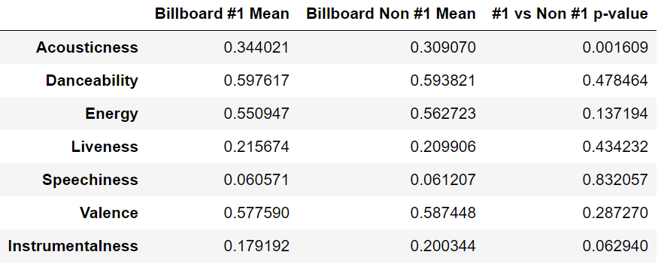
Findings
Our Null hypothesis was confirmed in that there is no statistical difference between song metrics of songs that were number one on the Billboard Hot 100 and those songs that never reached the number one position.
The only metric that returned a p-value of less that 0.005 was Acousticness.

Slide 12
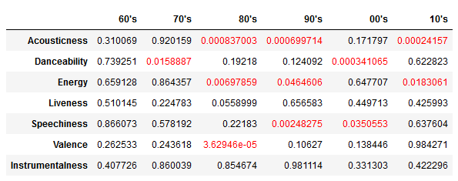
Findings

Slide 13
Post Mortem
Song metrics are created by Spotify and the algorithms are not publicly published.
Billboard Hot 100 criteria have changed since 1958.
Billboard has (many times) changed its methodology and policies to give the most precise and accurate reflection of what is popular. A very basic example of this would be the ratio given to sales and airplay. During the Hot 100's early history, singles were the leading way by which people bought music. At times, when singles sales were robust, more weight was given to a song's retail points than to its radio airplay.
Songs that have “remastered” on Greatest Hits or re-release albums
Sound similar to the human ear, but the API returns slightly different song metrics.
Spotify does not have a universal formatting for Songs/Artists
Billboard Hot 100 list parsed down to 20,040 songs from 28,000.

Slide 14
Post Mortem
We originally wanted to do a comparison between songs on the Billboard Hot 100 and songs that did not make the list. This proposal was later scraped due to difficulty in retrieving song metrics.
Additional difficulty was experienced with the song metrics in that Spotify had three possible returns; The metrics, nothing, or the string “(None)”.

